Slide 1

18ECE340T- MACHINE PERCEPTION WITH COGNITION
Unit 1: Computer Vision and Image Processing Fundamentals
References:
Digital Image Processing Third Edition, Woods, R.E. and Gonzalez, R.C., 2021.

Slide 2
Course Outcome (Unit 1)
Understand the fundamentals of image Processing, camera and color models
Review of Image processing methods
Introduction to image formation
Image models and Camera models
Sample programs for reading images, understanding pixels
Shadows, Colour Representation
Human color perception
Image color
Handling Color Images (MATLAB)

Slide 3
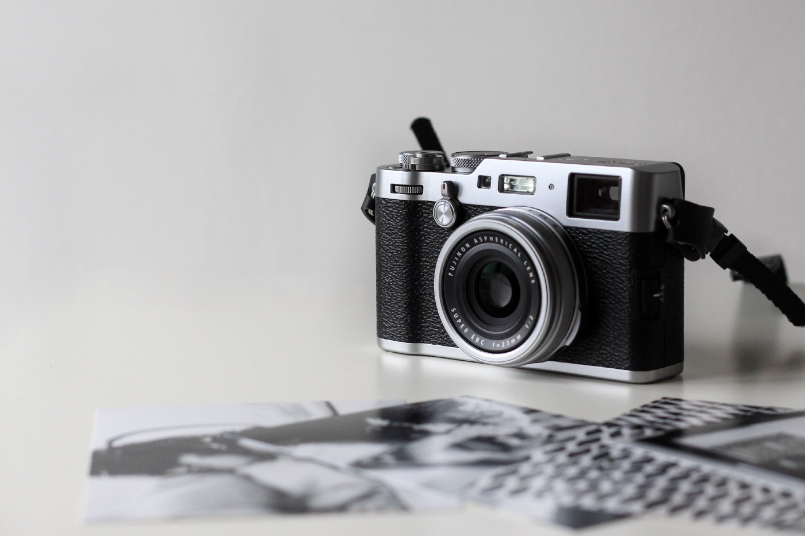
Session -1
Review of Image processing methods

Slide 4
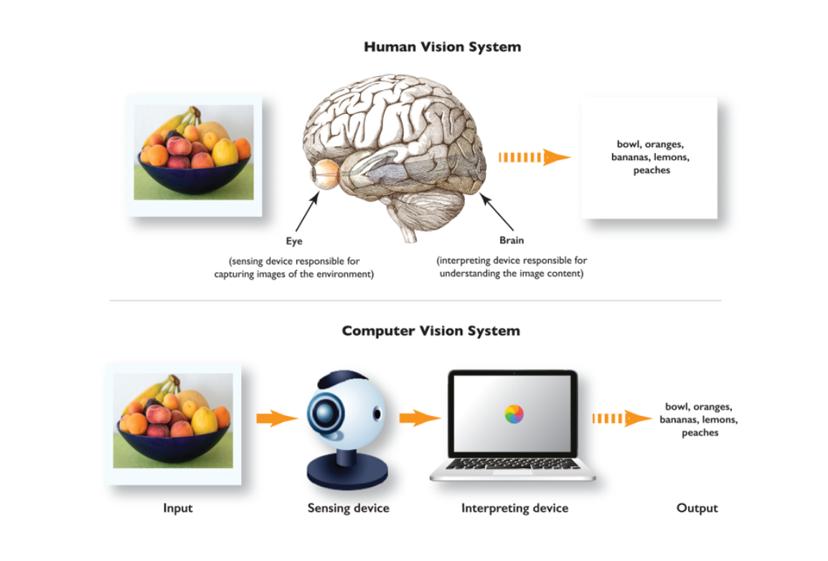
Introduction to Computer Vision
Brain processes images derived from the eyes.
Sensing element is eye .
Images are transmitted via optic nerve to the brain for further processing.
Human sight has the advantage of lifetimes of context to train how to tell objects apart, how far away they are, whether they are moving and whether there is something wrong in an image

Slide 5
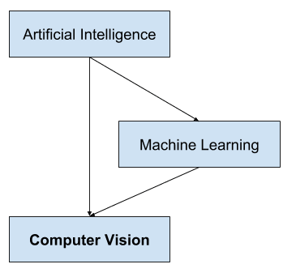
Introduction to Computer Vision
A field of AI that enables computers and systems to derive meaningful information from digital images, videos and other visual inputs and take actions or make recommendations based on that information
Processes images acquired from an electronic camera
Computer vision trains machines to perform these functions
It takes much less time with cameras, data and algorithms rather than retinas, optic nerves and a visual cortex

Slide 6
Introduction to Computer Vision
Computer Vision means the extraction of information from images, text, videos, etc. Sometimes computer vision tries to mimic human vision.
Computer Vision is a subset of computer-based intelligence or Artificial intelligence which collects information from digital images or videos and analyze them to define the attributes.
The entire process involves image acquiring, screening, analyzing, identifying, and extracting information.

Slide 7
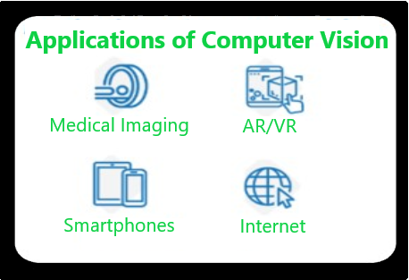
Applications of Computer Vision
Medical Imaging: MRI reconstruction, automatic pathology, diagnosis, and computer aided surgeries and more.
AR/VR: Object occlusion, outside-in tracking, and inside-out tracking for virtual and augmented reality.
Smartphones: Photo filters, QR code scanners, panorama construction, Computational photography, face detectors, image detectors like (Google Lens, Night Sight)
Internet: Image search, Mapping, photo captioning, Ariel imaging for maps, video categorization and more.

Slide 8
Applications of Computer Vision
Many popular computer vision applications involve trying to recognize things in photographs; for example:
Object Classification: What broad category of object is in this photograph?
Object Identification: Which type of a given object is in this photograph?
Object Verification: Is the object in the photograph?
Object Detection: Where are the objects in the photograph?
Object Landmark Detection: What are the key points for the object in the photograph?
Object Segmentation: What pixels belong to the object in the image?
Object Recognition: What objects are in this photograph and where are they?

Slide 9
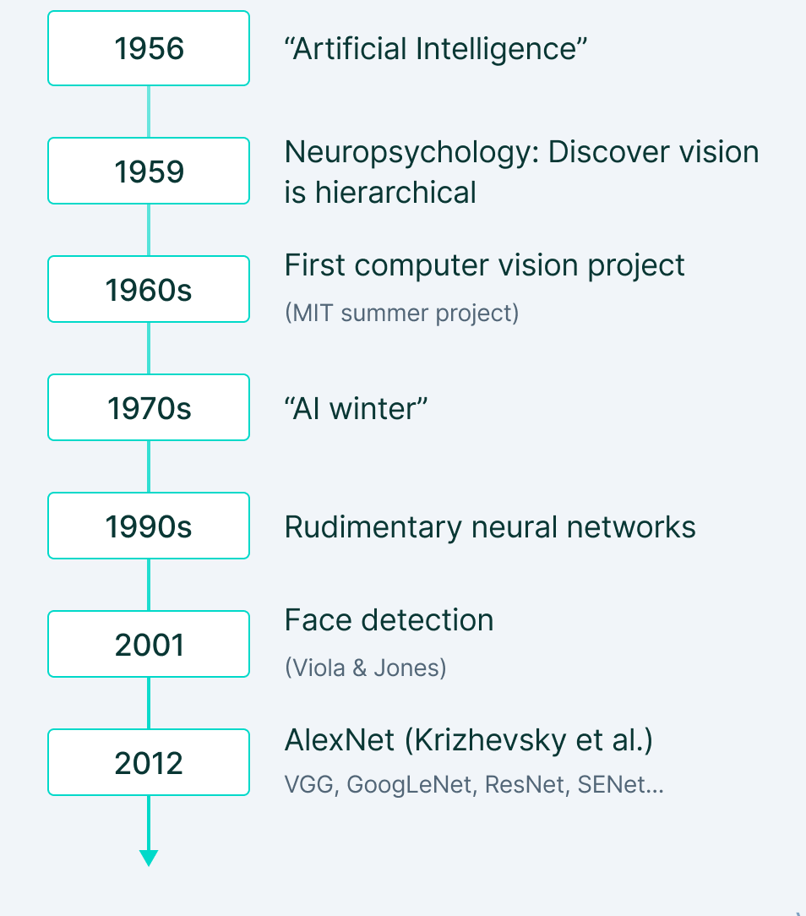
History of Computer Vision

Slide 10
Image Processing (a part of Computer Vision)
Digital Image Processing, or Image Processing, is a subset of Computer Vision - deals with enhancing and understanding images through various algorithms (rule-based and optimization-based algorithms).
Image Processing may be defined as the task of performing a set of operations on an image. based on data collected by algorithms to analyze and manipulate the contents of an image or the image data.
In Python, Libraries involved in performing Image Processing
Scikit-image; OpenCV; Mahotas; SimplelTK
SciPy; Pillow; Matplotlib

Slide 11
Computer Vision Vs Image Processing
Image processing studies image to image transformation. The input and output of image processing are both images.
Computer vision is the construction of explicit, meaningful descriptions of physical objects from their image. The output of computer vision is a description or an interpretation of structures in 3D scene.
Applications:
Robotics -
Medicine
Security
Transportation
Industrial Automation

Slide 12
What is an Image?
An image is represented by its dimensions (height and width) based on the number of pixels. For example, if the dimensions of an image are 500 x 400 (width x height), the total number of pixels in the image is 200000.
This pixel is a point on the image that takes on a specific shade, opacity or color. It is usually represented in one of the following:
Grayscale - A pixel is an integer with a value between 0 to 255 (0 is completely black and 255 is completely white).
RGB - A pixel is made up of 3 integers between 0 to 255 (the integers represent the intensity of red, green, and blue).
RGBA - It is an extension of RGB with an added alpha field, which represents the opacity of the image.

Slide 13
Image Processing
Image processing requires fixed sequences of operations that are performed at each pixel of an image.
The image processor performs the first sequence of operations on the image, pixel by pixel.
Once this is fully done, it will begin to perform the second operation, and so on.
The output value of these operations can be computed at any pixel of the image.
Image processing is the process of transforming an image into a digital form and performing certain operations to get some useful information from it.
The image processing system usually treats all images as 2D signals when applying certain predetermined signal processing methods.

Slide 14
Main Types (Purpose) of Image Processing
Visualization - Find objects that are not visible in the image
Recognition - Distinguish or detect objects in the image
Sharpening and restoration - Create an enhanced image from the original image
Pattern recognition - Measure the various patterns around the objects in the image
Retrieval - Browse and search images from a large database of digital images that are similar to the original image

Slide 15
Main Types (Purpose) of Image Processing
Visualization - Find objects that are not visible in the image
Recognition - Distinguish or detect objects in the image
Sharpening and restoration - Create an enhanced image from the original image
Pattern recognition - Measure the various patterns around the objects in the image
Retrieval - Browse and search images from a large database of digital images that are similar to the original image.

Slide 16
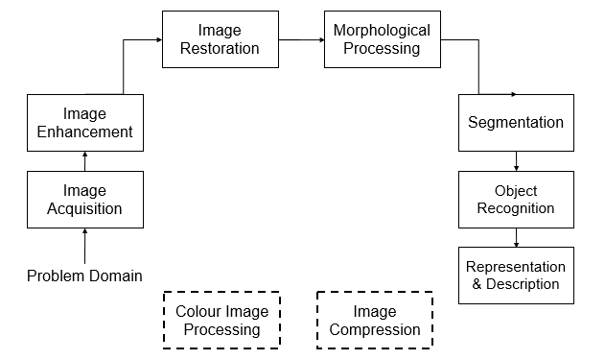
Block Diagram of Image Processing

Slide 17
Fundamental Image Processing Steps
Image Acquisition - first step in image processing. This step is also known as preprocessing in image processing. It involves retrieving the image from a source, usually a hardware-based source.
Image Enhancement - the process of bringing out and highlighting certain features of interest in an image that has been obscured. This can involve changing the brightness, contrast, etc.
Image Restoration - the process of improving the appearance of an image. However, unlike image enhancement, image restoration is done using certain mathematical or probabilistic models.
Color Image Processing - includes a number of color modeling techniques in a digital domain. This step has gained prominence due to the significant use of digital images over the internet.

Slide 18
Fundamental Image Processing Steps
Wavelets and Multiresolution Processing - Wavelets are used to represent images in various degrees of resolution. The images are subdivided into wavelets or smaller regions for data compression and for pyramidal representation.
Compression - process used to reduce the storage required to save an image or the bandwidth required to transmit it. This is done particularly when the image is for use on the Internet.
Morphological Processing - set of processing operations for morphing images based on their shapes.
Segmentation - one of the most difficult steps of image processing. It involves partitioning an image into its constituent parts or objects.

Slide 19
Fundamental Image Processing Steps
Representation and Description - After an image is segmented into regions in the segmentation process, each region is represented and described in a form suitable for further computer processing.
Representation deals with the image’s characteristics and regional properties. Description deals with extracting quantitative information that helps differentiate one class of objects from the other.
Recognition - assigns a label to an object based on its description.

Slide 20
Benefits of Image Processing Steps
Here are some of the most useful benefits of image processing, regardless of the field of operation:
The digital image can be made available in any desired format (improved image, X-Ray, photo negative, etc)
It helps to improve images for human interpretation
Information can be processed and extracted from images for machine interpretation
The pixels in the image can be manipulated to any desired density and contrast
Images can be stored and retrieved easily
It allows for easy electronic transmission of images to third-party providers

Slide 21
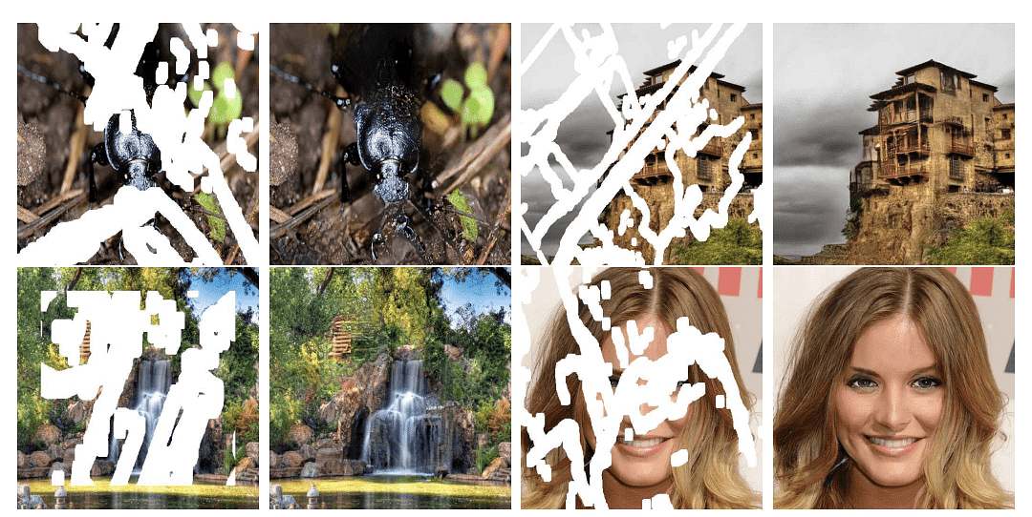
Reconstruction of Damaged Image

Slide 22
Types of Images
Binary Image – only two pixel value – Black – 0 & White – 1 : Monochrome
Black and White Image – No gray level – Portable bit map (format)
2,3,4,5,6 bit colour format– Not in use today – 2 (4 colour), 3 ( 8 colour)…. 6 (64 colour)
8 bit colour format – Famous image format – Grayscale Image- 8 bit has 256 colours (0 – black – 255 – White and 127 – Gray colour)
16 bit colour format – 65536 different colours – High Colour Format – RGB format -5 bits for R, 6 bits for G, 5 bits for B..
24 bit colour format – True colour format – 8 bits for R, 8 bits for G, 8 bits for B – PPM Portable pixmap (Linux) – bitmap (Windows)

Slide 23
Image Processing
Image processing basically involves the following three steps.
Importing an image with an optical scanner or digital photography.
Analysis and image management including data compression and image enhancement and visual detection patterns such as satellite imagery.
It produces the final stage where the result can be changed to an image or report based on image analysis.
Image processing is a way by which an individual can enhance the quality of an image or gather alerting insights from an image and feed it to an algorithm to predict the later things.

Slide 24
Digital Image
Digital Image
a two-dimensional function
x and y are spatial coordinates
The amplitude of f is called intensity or gray level at the point (x, y)
When x, y, and the amplitude values of f are all finite, discrete quantities, we call the image a digital image
A digital image is composed of a finite number of elements, each of which has a particular location and value.
These elements are referred to as picture elements, image elements, pels, and pixels.

Slide 25
Session -2
Introduction to Image Formation

Slide 26
Image Processing to Computer Vision
The continuum from image processing to computer vision can be broken up into low-, mid- and high-level processes.
Low Level Process | Mid Level Process | High Level Process
Input: Image Output: Image Examples: Noise removal, image sharpening | Input: Image Output: Attributes Examples: Object recognition, segmentation | Input: Attributes Output: Understanding Examples: Sense understanding, autonomous navigation

Slide 27
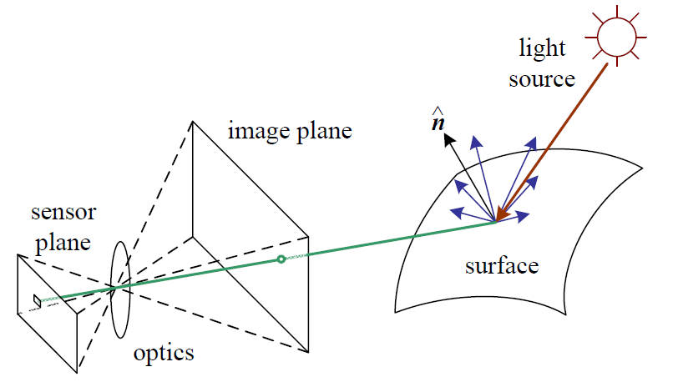
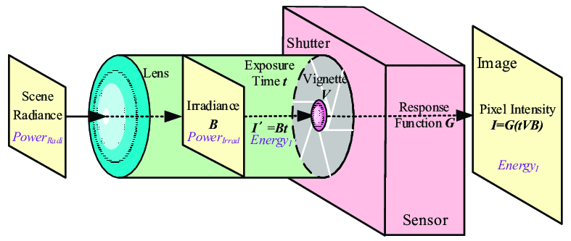
Photometric Image Formation
The light from a source is reflected on a particular surface. A part of that reflected light goes through an image plane that reaches a sensor plane via optics.
Few factors that affect image formation are:
The strength and direction of the light emitted from the source.
The material and surface geometry along with other nearby surfaces.
Sensor Capture properties

Slide 28
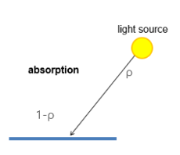
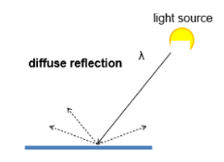
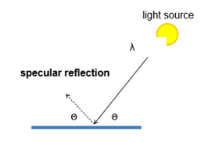
Photometric Image Formation
Reflection and Scattering
Images cannot exist without light. Light sources can be a point or an area light source. When the light hits a surface, three major reactions might occur – Absorption, Diffuse and Specular Reflection
Some light is absorbed. That depends on the factor called ρ (albedo).
Low ρ of the surface means more light will get absorbed.
Some light gets reflected diffusively, which is independent of viewing direction.
It follows Lambert’s cosine law that the amount of reflected light is proportional to cos(θ).
E.g., cloth, brick.
Some light is reflected specularly, which depends on the viewing direction.
E.g., mirror.

Slide 29
Photometric Image Formation
Reflection and Scattering
The most common model of light scattering is the Bidirectional Reflectance Distribution Function (BRDF).
It gives the measure of light scattered by a medium from one direction into another.
The scattering of the light can determine the topography of the surface — smooth surfaces reflect almost entirely in the specular direction, while with increasing roughness the light tends to diffract into all possible directions.

Slide 30
Photometric Image Formation
Colour
Visible light is only a small portion of a large electromagnetic spectrum.
Two factors are noticed when a colored light arrives at a sensor:
Colour of the light
Colour of the surface
Bayer Grid/Filter is an important development to capture the color of the light. In a camera, not every sensor captures all the three components (RGB) of light. Inspired by human visual preceptors, Bayers proposed a grid in which there are 50% green, 25 % red, and 25% blue sensors.
Demosaicing algorithm is then used to obtain a full-color image where the surrounding pixels are used to estimate the values for a particular pixel.

Slide 31
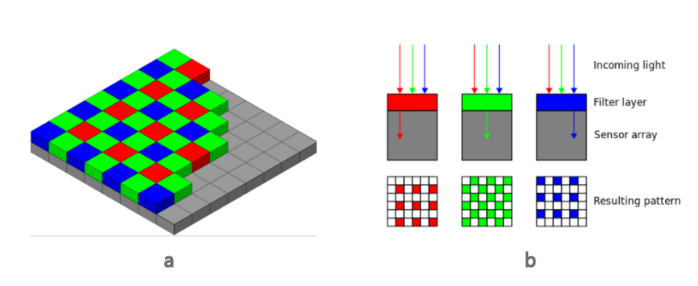
Photometric Image Formation

Slide 32
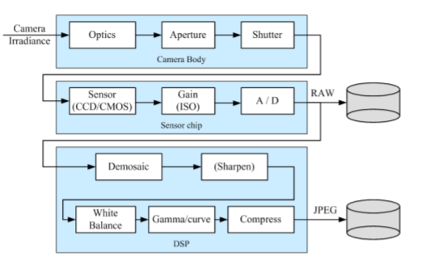
Photometric Image Formation
Image Sensing Pipeline
Image Sensor
The camera sensor can be CCD or CMOS. In charged coupled device (CCD).
A charge is generated at each sensing element and this photogenerated charge is moved from pixel to pixel and is converted into a voltage at the output node. Then an analog to digital converter (ADC) converts the value of each pixel to a digital value.
The complementary metal-oxide-semiconductor (CMOS) sensors work by converting charge to voltage inside each element as opposed to CCD which accumulates the charge.
CMOS signal is digital and therefore does not need ADC. CMOS is widely used in cameras in the current times

Slide 33
Photometric Image Formation
While Clicking on Camera
Shutter Speed: It controls the amount of light reaching the sensor
Sampling Pitch: It defines the physical space between adjacent sensor cells on the imaging chip.
Fill Factor: It is the ratio of active sensing area size with respect to the theoretically available sensing area (product of horizontal and vertical sampling pitches)
Chip Size: Entire size of the chip
Sensor Noise: Noise from various sources in the sensing process
Resolution: It tells you how many bits are specified for each pixel.
Post-processing: Digital image enhancement methods used before compression and storage.

Slide 34
Photometric Image Formation
While Clicking on Camera
Shutter Speed: It controls the amount of light reaching the sensor
Sampling Pitch: It defines the physical space between adjacent sensor cells on the imaging chip.
Fill Factor: It is the ratio of active sensing area size with respect to the theoretically available sensing area (product of horizontal and vertical sampling pitches)
Chip Size: Entire size of the chip
Sensor Noise: Noise from various sources in the sensing process
Resolution: It tells you how many bits are specified for each pixel.
Post-processing: Digital image enhancement methods used before compression and storage.

